Slide 1
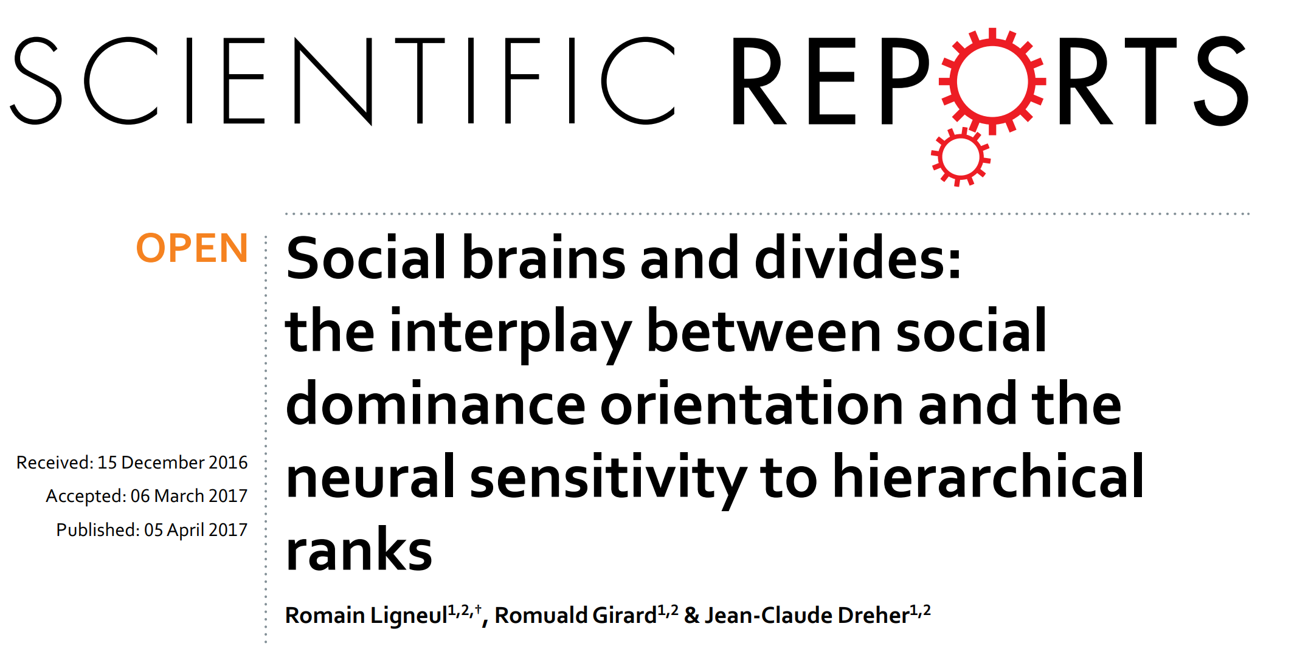

Slide 2
Introduction
Several important demographic are often assessed by the Social Dominance Orientation scale (SDO).
The neural sensitivity to social dominance may accompany interindividual variability in the predisposition towards anti-egalitarianism.

Slide 3
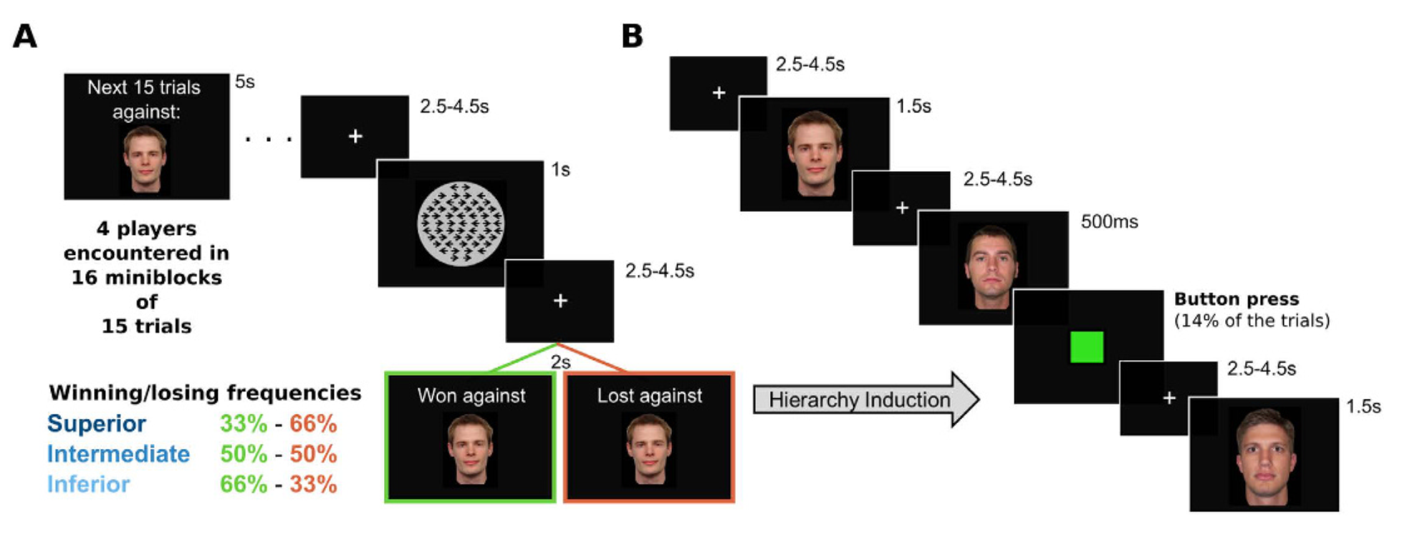
Task
Four player faces, participants’ own faces, ‘scrambled face’
Each stimulus repeat 30 times.
GLM: Six interested regressors

Slide 4
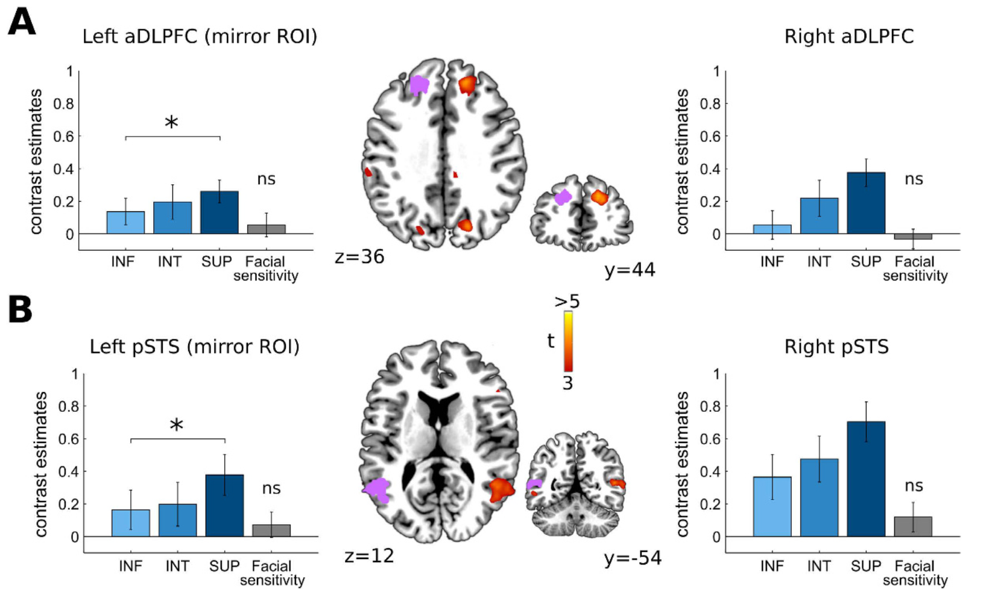
Result

Slide 5
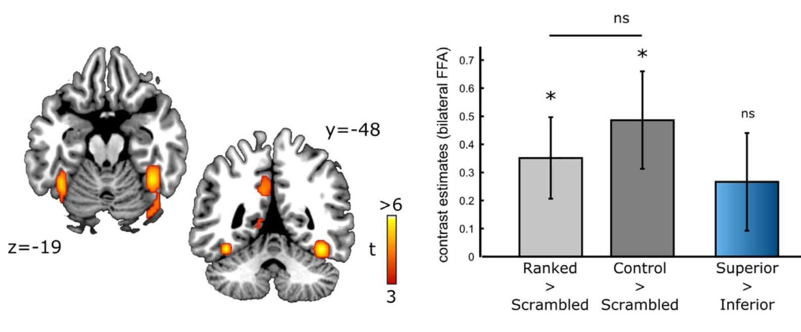
Result

Slide 6
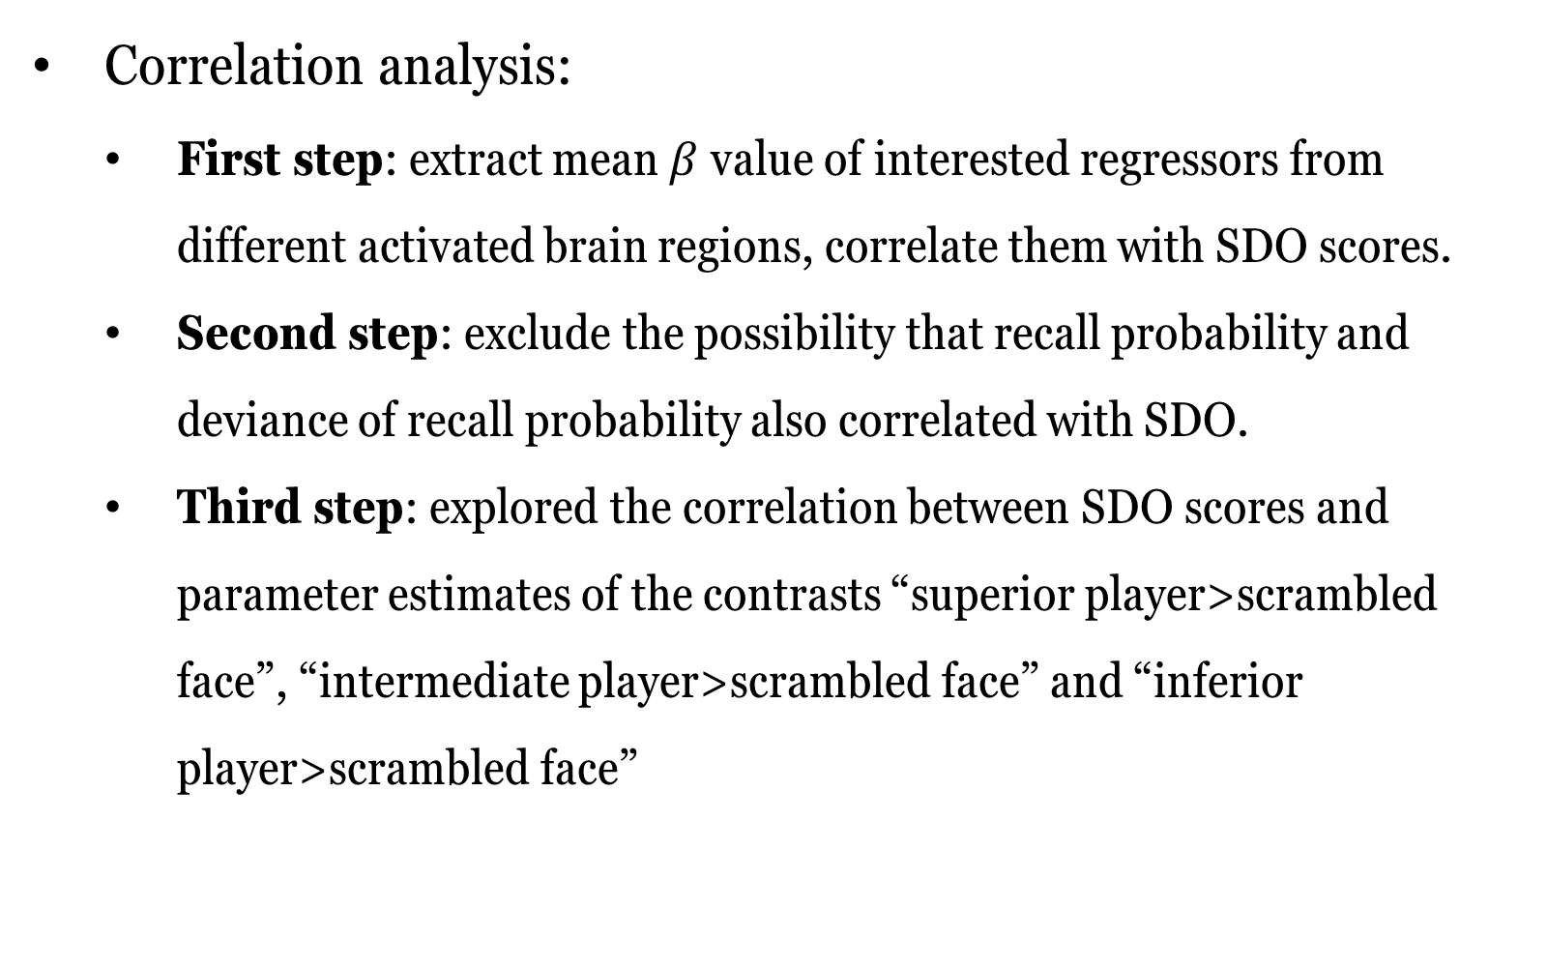
Result
Correlation analysis:
First step: extract mean $β$ value of interested regressors from different activated brain regions, correlate them with SDO scores.
Second step: exclude the possibility that recall probability and deviance of recall probability also correlated with SDO.
Third step: explored the correlation between SDO scores and parameter estimates of the contrasts “superior player>scrambled face”, “intermediate player>scrambled face” and “inferior player>scrambled face”

Slide 7
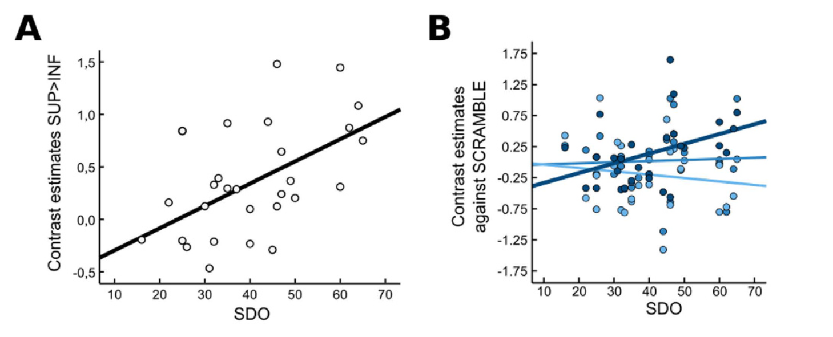
Result

Slide 8
Discussion
DLPFC and the pSTS activations observed here may constitute the minimal, task-independent brain network involved in social rank perception.
The brain structure might play a significant role in the prevalence of employment discrimination against women or ethnic minorities, which is directly related to the conservative and hierarchy-enhancing attitudes indexed by SDO scores.
Polarization may stem from variations in the neural sensitivity to others’ skills, and more particularly to those of dominant others.

Slide 9
Discussion
The inclination to affirm superiority over inferior individuals and the motivation to reach high positions in the social hierarchy might be envisioned as confidence-enhancing or stress-coping strategies.

